Slide 1


RewardWise
Stop Wasting Days. Start Planning Travel “Smarter”!
AI-Powered Travel Assistant that optimizes your “Wallet”
🌐 rewardwise-app.vercel.app
Developer Team Match | February 10, 2026
Autumn, Anshu, Eshma, Pranay, Sarabjeet, Seba and Smital

Slide 2
What is the Problem we’re solving?
$5.4B
8 hrs
57%
47
Points wasted annually by US travelers
Average research time per trip
Feel overwhelmed by options
Options shown — zero recommendations
"I spent 8 hours researching how to book Paris with my points. I still don't know if I did it right."
— Marcus, 34 (used 487K Chase points)
Every competitor shows OPTIONS. None give THE VERDICT.
Notes:
Here is the problem we are solving. Millions of Americans spend hours, days researching the most affordable way to book their travel. 60 million customers take roughly 3 trips per year. That's 180 million trip decisions annually. At $150 average optimization value, that's a $27 billion TAM.
Our target: 10 million 'motivated but time-constrained' travelers. That's a $1.5 billion serviceable market.
They accumulate points intentionally but don't have three hours to research every trip. Their points are kept at many location, banks, Airline loyalty programs, and do not know when and how to make the best use of them. Many of these points expire! Current competitors show 10+ options on their search. OVERWHELMING! No ONE is GIVING THEM A SINGLE RECOMMENDATION!
Millions of travelers intentionally collect points — but when it’s time to book, the experience falls apart.
People spend 8 hours per trip researching, see dozens of options, and still walk away asking: “Did I just waste my points?”
That confusion leads to $5.4 billion in points wasted every year — through bad redemptions, missed transfers, or points expiring unused.
The issue isn’t lack of options. Every competitor already shows options.
The real problem is that no one gives a verdict.
Travelers don’t want 47 ways to book a flight. They want one clear recommendation they can trust.
That’s the gap we’re solving.

Slide 3
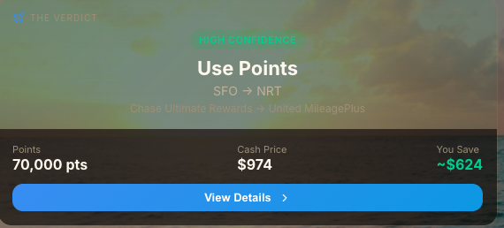
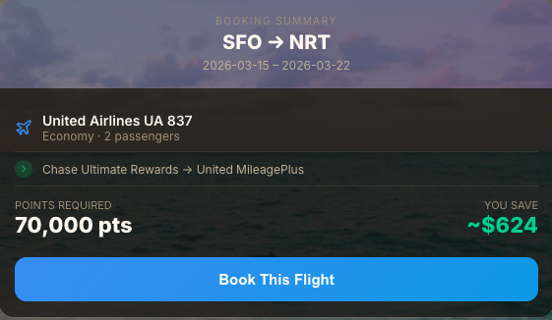
What is our Solution?
BEFORE (Competitors)
Point.me: "Here are 47 ways to book this flight"
PointsYeah: "Here are all flights in the next 8 days"
Google Flights: Only cash. Many options. No ways to utilize points
AFTER (RewardWise)
✅ Transfer 70K Chase → United
✅ Book Flight AF123, June 15
✅ Save $8,160 vs cash
✅ Value: 5.8¢ per point
✅ Confidence: 94%
Notes:
First, we unify your balances into one wallet view. Your 140K Chase plus 30k Amex plus 20K United Airlines.
Second, we calculate the optimal transfer path. Don't send Chase to Air Canada—send it to United instead. Same flight, 40% fewer points.
Third, we deliver The Verdict: a clear recommendation. Sometimes that's 'use points.' Sometimes it's 'pay cash this time—your points are worth more saved for now.'
We're not a search engine showing you 47 options and saying 'you decide.' We tell you what to do."
MOAT -> 1) VERDICT- single recommendation. Cash or points or both and also thinking long term.
2) As we continue to learn thru customer data, we can refine our decision analysis and also give hooks (e.g. alerts, recommendations) to users for future trips.
TBD - 1) Even though our mocks are giving the best recommendation we are seriously considering back up options (say next 2-4 less optimal) in fine print. We can A/B test this experience. however for this presentation we are keeping it simple and presenting the best recommendation.
Today’s tools stop at showing options. We go one step further — we tell you what to do.
First, we unify all your points into a single wallet view — Chase, Amex, airline miles — so users don’t have to mentally track balances across programs.
Second, we compute the optimal transfer and booking path. Not just where you can transfer points — but where you should. Often that means the same flight for 40% fewer points.
And finally, we deliver The Verdict.
One clear recommendation:
Use points
Pay cash this time
Or save your points for a better future trip
We’re not another search engine showing 47 options and saying “you decide.” We give a single, confidence-backed answer — optimized not just for this trip, but long-term value.

Slide 4


Who is our Customer?
Marcus Miller
Maria Gavras
Creative Services Manager, Disney | LA, CA
8-12 work trips/year + personal travel
Associate Professor, NYU | New York City
2 Greece trips/year with family of 4
Pain Points:
Pain Points:
• Time drain (8+ hrs research)
• Analysis paralysis
• Constant second-guessing
• Wasted points value
• Feels overwhelmed
• No time to research
• Afraid to waste points
• Doesn't know "the rules"
Needs: Clear verdict, quick answer, expert validation
Needs: Simple solution, stretch budget, confidence

Slide 5
What do surveys tell us?
Sample size (n=39)
Key Finding: The problem isn't information — it's CONFIDENCE
64%
49%
69%
44%
"Not knowing if it's worth it"
Double-check multiple sources
Want "absolute best value"
Would book immediately
Top pain point
Don't trust their own research
Perfectionism creates paralysis
If given a trusted verdict
Top Frustrations:
Finding availability
Transferring points
Doing the math
38%
35%
27%
Notes:
Summary from the user surveys should suffice

Slide 6
Who are our competitors?
Competitor | What They Do | Gap
Hopper | AI price prediction (cash only) $5B valuation, 120M+ downloads | No points optimization
Point.me | Search 30+ programs, 150+ airlines $38.5M raised | 47 options, no verdict 109 sec search time
PointsYeah | Fast search (24 sec) Strong free tier | No recommendations User decides alone
RewardWise | AI decision engine One verdict, not options | ✅ THE ANSWER
Our Winning Position
1. Verdict > Search — we're the decision layer, not infrastructure
2. Zero marginal cost AI — scales infinitely vs $200/booking concierge
3. Confidence as product — solve trust gap, not information gap
Notes:
Just use executive summary from the PMA doc on competitor analysis.

Slide 7
What is our AI vision?
ML decides. LLM explains.
User Query
LLM Parsing
Agents
ML Engine
Verdict
→
→
→
→
Natural language
Intent extraction
Seats.aero
XGBoost + Ranking
Confidence score
Technology Stack (MVP Prioritized)
Layer | Tech | Purpose | Priority
LLM | Claude/GPT-4o Mini | Intent parsing, verdict explanation | P0
ML | XGBoost, LambdaMART | Cash vs points, path ranking | P0
Agents | Seats.aero | Real-time availability, balance sync | P0
RAG | Transfer rules DB | Award charts, program rules | P0
Eval | Isotonic Regression | Confidence calibration | P0
Notes:
If developers ask about “are their integration points we need to think about” - we can tell them at launch it would manual for users to tell us “what is in their wallet” through forms, but eventually we want to reduce user friction by directly integrating with banks through Plaid.

Slide 8
AI Hypothesis
IF
We deliver high-confidence (>90% accuracy) cash vs points recommendations instantly (<5 sec) by combining:
• ML-based ranking (LambdaMART)
• RAG-grounded program rules (transfer partners, award charts)
• LLM-powered verdict explanation
Time-poor travelers will make booking decisions faster and more confidently:
• >50% reduction in decision time
• >75% positive verdict feedback
• Higher trust → repeat usage → premium conversion
THEN
Success Metrics:
Verdict Accuracy
>90%
User confirms correct recommendation
Response Time
<5 sec
Query to verdict latency
User Trust
>75%
Positive feedback on recommendations

Slide 9
What is our Roadmap?
Week 4-6
Week 7-8
Week 8-10
Week 11
Core Engine
AI Layer
User Experience
Launch
• Search interface
• Points portfolio input
• Award chart DB
• Basic recommendation algorithm
• AI recommendation
• Value calculation
• Result display
• Deep-links
• Google OAuth
• Portfolio dashboard
• Booking tracking
• Metrics
• Bug fixes
• Landing page
• Deploy to beta
Working search
Full flow
Polished UX
Live beta-product

Slide 10
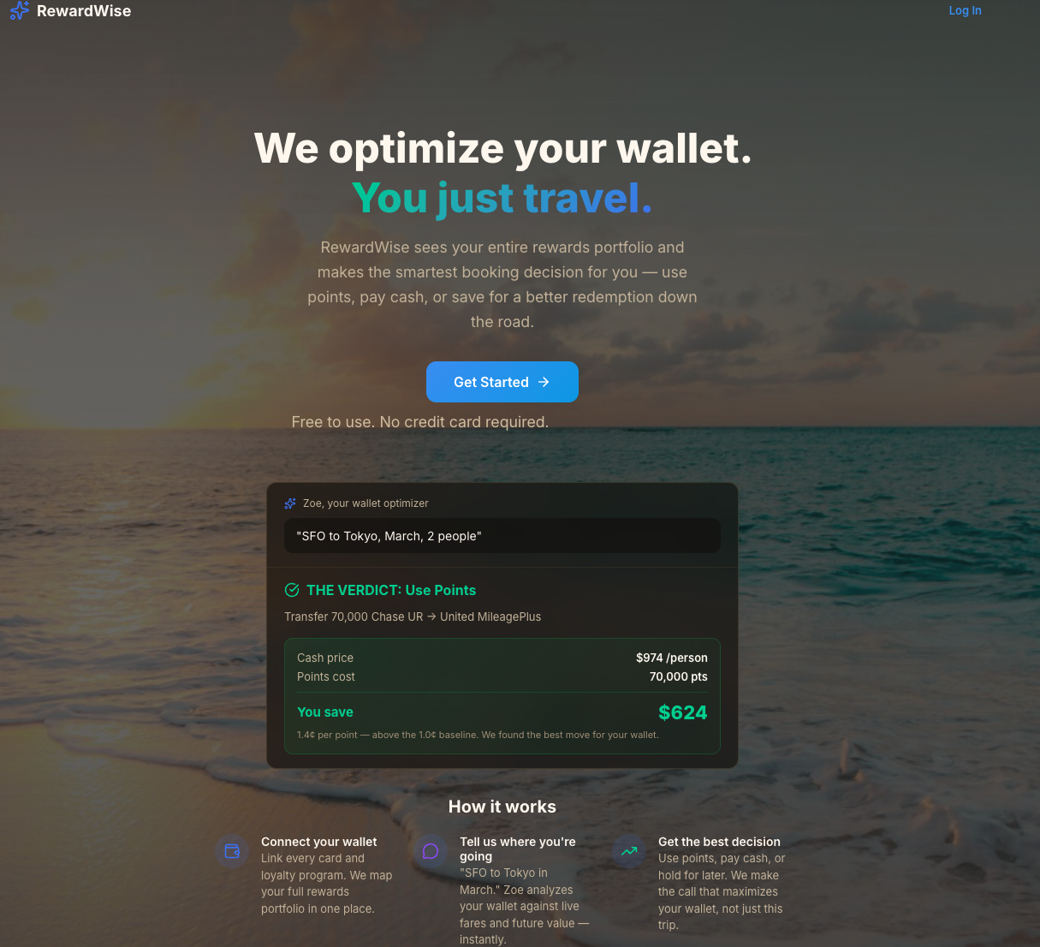
What is our User Experience? (1 of 3)
Login page

Slide 11
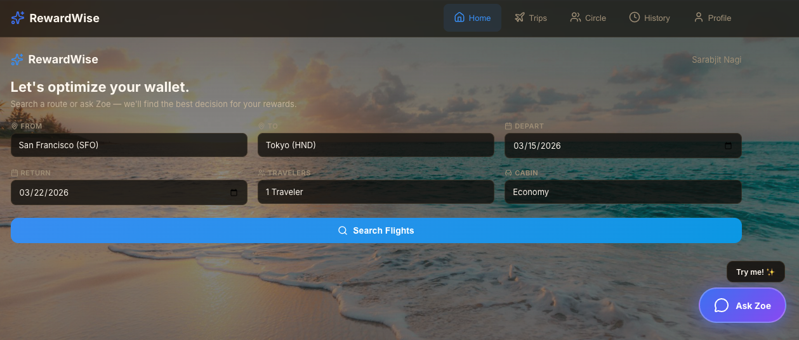
What is our User Experience? (2 of 3)
Home Page- Search & Discovery experience

Slide 12
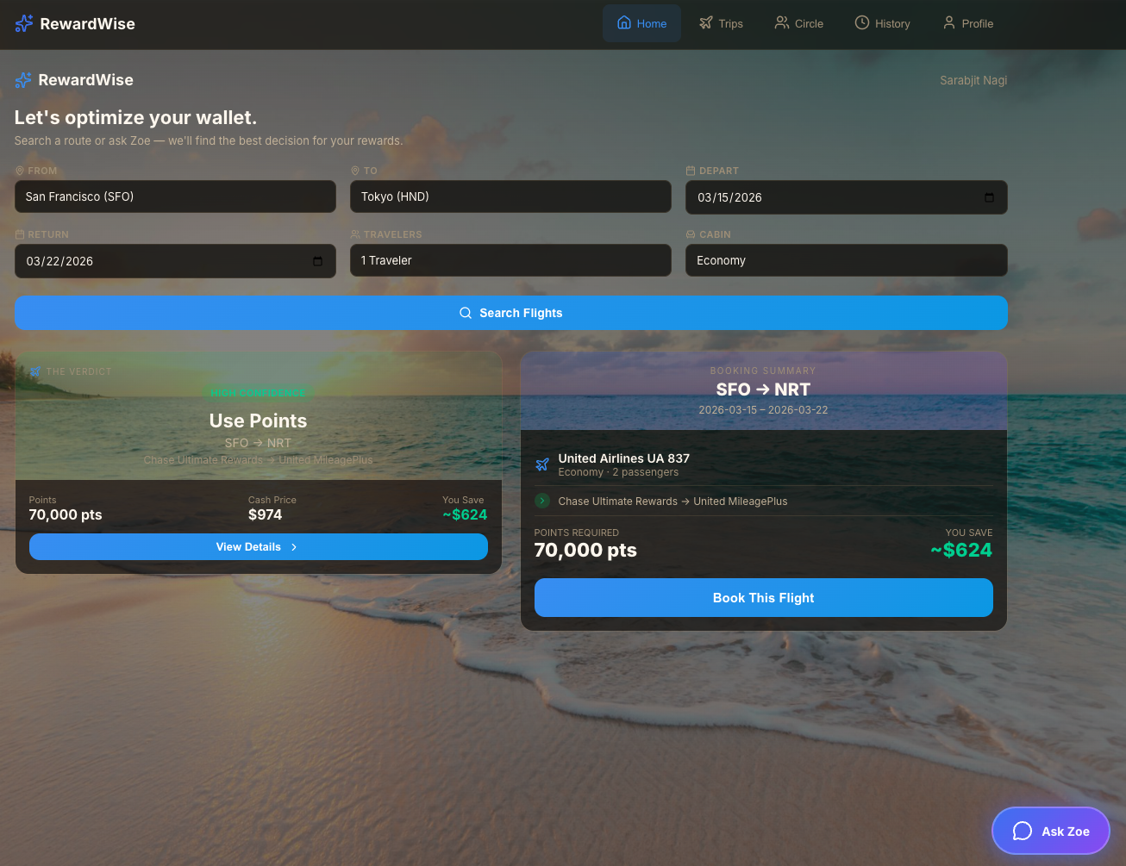
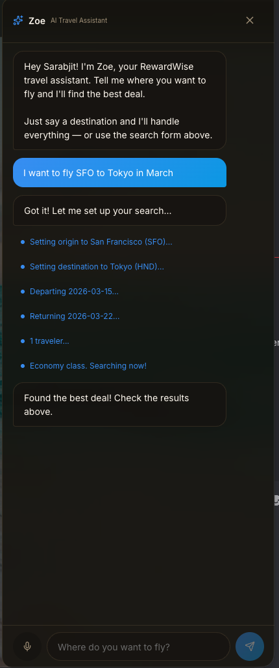
What is our User Experience? (3 of 3)
Search & Discovery experience aided by Zoe, the AI assistant

Slide 13
What do we need?
Frontend
(React/Next.js)
Backend
(Node.js/Python)
Data Scientist
You'll build:
You'll build:
You'll build:
• Build search interface
• Implement mockups
• Mobile-responsive(iOS)
• Portfolio dashboard
web-first
• API & database
• Seats.aero integration
• Recommendation algo
• AI integration
Deploying solutions
• ML Algorithm(XGBoost)
• Data Pre-processing
• A/B Testing (create synthetic data)
Skills: React, TypeScript, Tailwind
Skills: Node.js, Python
What You'll Gain:
✓ Real AI systems — ML + RAG + LLM ✓ Complex architecture ✓ High-impact ownership ✓ Fast iteration

Slide 14
Thank You
Questions?
🌐 rewardwise-app.vercel.app
RewardWise, saving you $1000+ in your next Travel adventure!

Slide 15
What have we completed so far?
✅ Market validation survey
39 responses, key insights validated
✅ Competitive analysis
Point.me, Points Yeah, Gondola, Hopper
✅ AI architecture defined
ML + LLM + Agents + RAG stack
✅ User flows documented
12 flows with ML model specs
✅ Technology matrix
5 features prioritized (P0, P0.5, P1)
✅ Prototype to play with
rewardwise-app.vercel.app
🔜 MVP development
Starting post team match

Slide 16
Appendix: Technical Architecture
Frontend (Vercel): React + Tailwind CSS + React Router + Axios
Backend (Railway/Render): Node.js + Express | Auth Service (JWT) | Value Engine | Award Chart Service
Database: Supabase PostgreSQL
AI & ML: Recommendation Engine + Custom Algorithm
Deployment: Vercel (FE) + Railway/Render (BE) + Supabase (DB) + Claude API / GPT-4

Slide 17
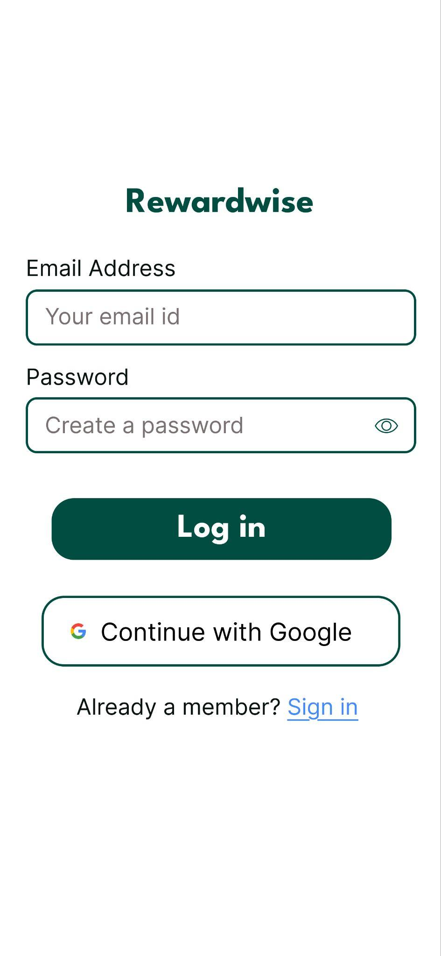
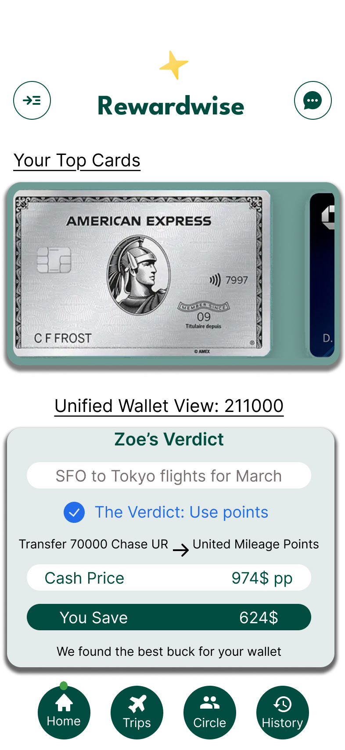
App Prototype

